Slide 1
Analysis of Average Daily Rate and Lead Time
Variance Analysis
Regression Analysis
Trend Analysis

Slide 2

Hotel Booking Analysis

Slide 3
Objective
My client wants a report to understand the relationship between average daily rate(ADR) for hotels and the lead time before booking. He has told to make a Power Bi Dashboard for the same.
Need to filter out 'is_canceled’
Create a simple linear regression between two variables.
About the dataset shared by client : The data set contains booking information for a city hotel and a resort hotel.
hotel (str) - Hotel (H1 = Resort Hotel or H2 = City Hotel)
lead_time (int) - Number of days that elapsed between the entering date of the booking into the PMS and the arrival date
arrival_date_year (int) - Year of arrival date
arrival_date_month (str) - Month of arrival date
arrival_date_week_number (int) - Week number of year for arrival date
arrival_date_day_of_month (int) - Day of arrival date
country (str) - Country of origin. Categories are represented in the ISO 3155–3:2013 format
adr (float) - Average Daily Rate as defined by dividing the sum of all lodging transactions by the total number of staying nights
And many other coloums.

Slide 4
Aspect of Python
Load Data in Python
Load and read shared data in python and remove empty data.
Filter Required data
Column ‘is_canceled’ value indicating if the booking was canceled (1) or not (0)
Filter Data for Not canceled
Creating new dataset for ’not cancelled’ in python and converting into csv to load in Power BI.
Python Code
Scripting codes of Python to preparing visualization on local python for new data
Creating new table for date in python
As the data is time series and need to create visual , we need a data table. Scripting codes of Python for date table.

Slide 5
Aspect of Power BI & Power BI Scripting
Load data in Power Bi
Table Creation
Create Date table with pyhon code in power bi query –python script
Column Creation
Create date column in Hotel table
Creating Relation Between Tables
Build relation between Date Table and Hotel table in power bi query editor as its was required for DAX
Creating New Table of Regression
Creating new table of regression with help of scipy linregress for lead_time and adr
Predicting adr for 365 days
Creating sclicer for 365 days to predict adr, with dax for predicted adr

Slide 6
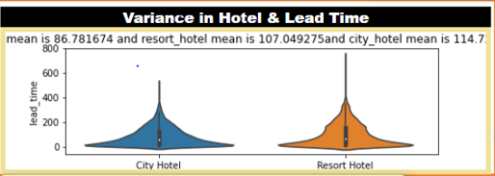
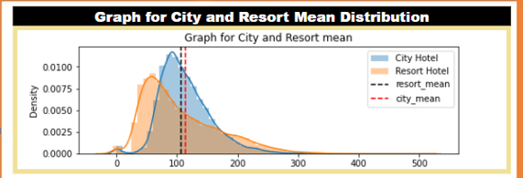
Distribution Analysis of ADR and Lead Time
Observation :
Lead time for Resort is more as compared to city hotel

Slide 7
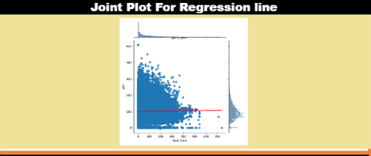
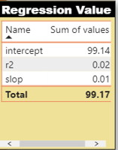
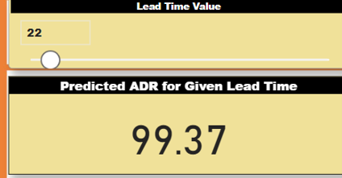
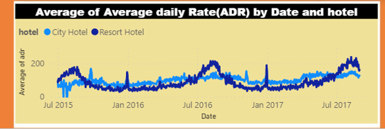
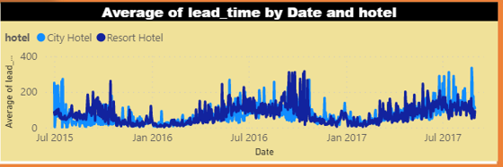
Analysis of Regression
Created line of regression for adr & lead time which is constant.
Presenting trend between average ADR by Date and Hotel & Lead Time by Date and Hotel.
Also predicted adr for 365 days

Slide 8
